Slide 1
BLOXORZ
B07901020 劉昀昇

Slide 2
CONTENT
Brief introduction
Problem formulation
Bloxorz graph
CNF encoding
Definition
Rules
Experiment

Slide 3
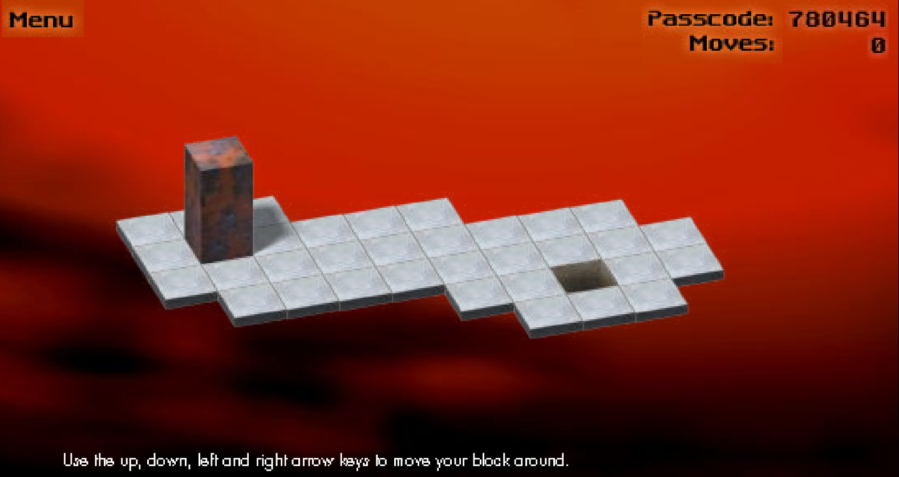
Brief introduction
https://www.mathplayground.com/logic_bloxorz.html
An online puzzle game where players move a 1 by 1 by 2 block by tilting it on a subset of the two dimensional grid. The block was moved from initial position to upright position on the destination square

Slide 4
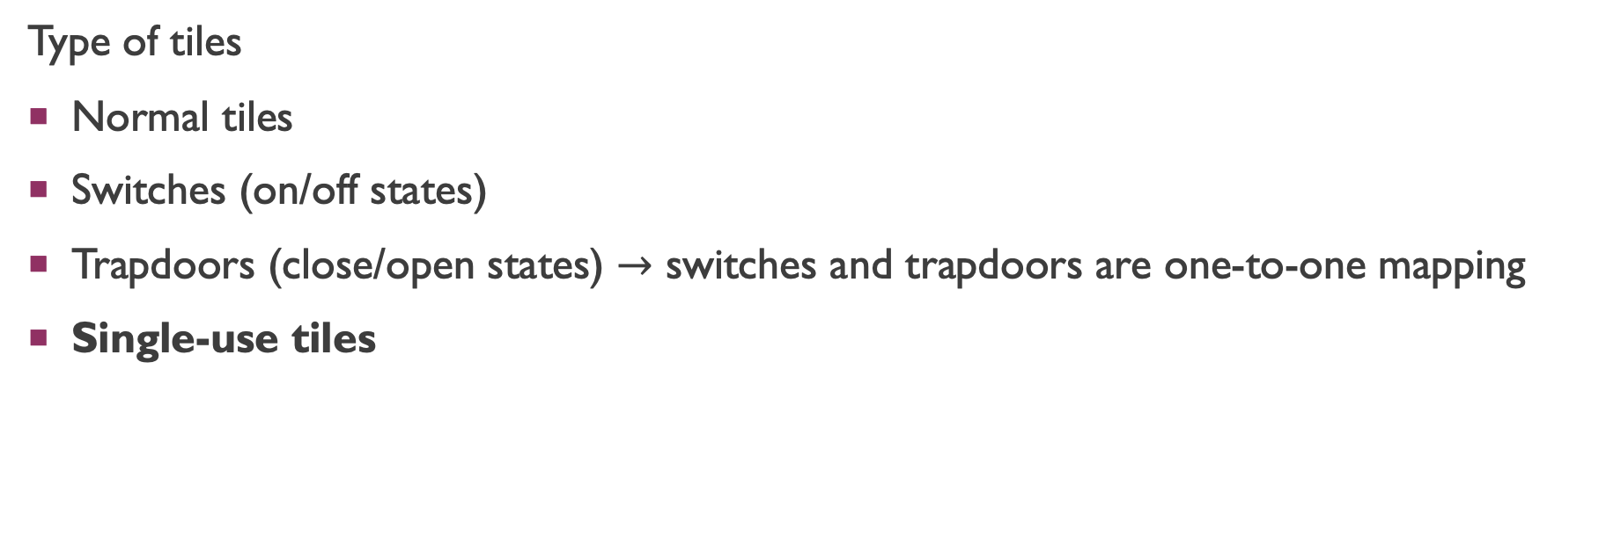
Brief introduction
Type of tiles
Normal tiles
Switches (on/off states)
Trapdoors (close/open states) $→$ switches and trapdoors are one-to-one mapping
Single-use tiles

Slide 5
Complexity of bloxorz
Van Der Zanden, Tom C., and Hans L. Bodlaender. "PSPACE-completeness of Bloxorz and of games with 2-buttons." arXiv preprint arXiv:1411.5951 (2014).
Dec. : decision problem
Opt. : optimization problem, whether it takes less than k steps
Here we focus on single-use tiles problem, it can be reduced from 3-CNF (NPC)

Slide 6
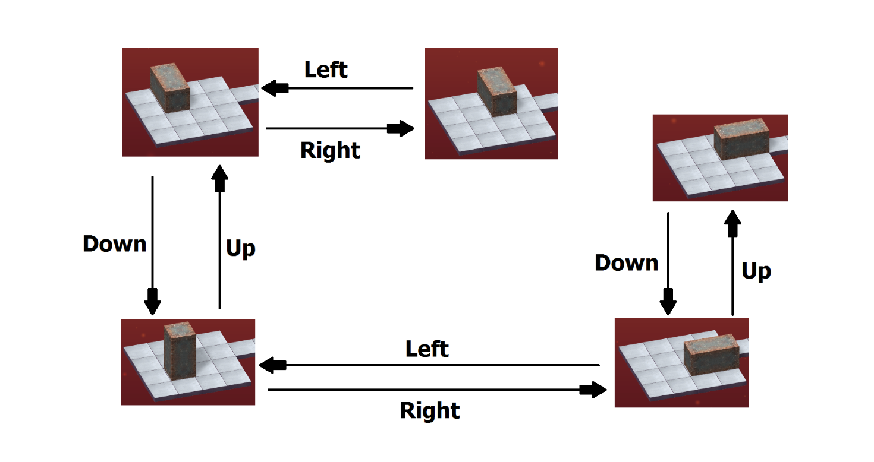
Problem formulation
Instance
Given a level of Bloxorz graph made up by a list of single-use tiles, and a 1 by 1 by 2 block
Question
Is there a sequence of legal move (right, left, down, up) to move from start point to up-right position on goal square

Slide 7
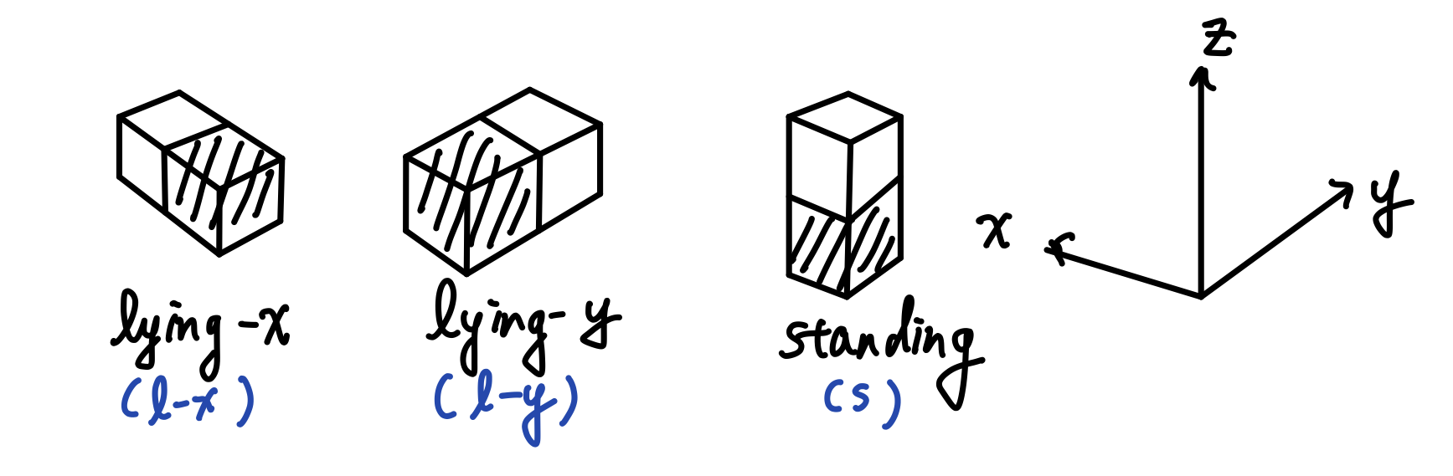

Bloxorz graph
Given a level of Bloxorz, suppose it has total $𝕋$ tiles. For each tile the block can have three unique states on it (choose the closer-to-origin unit). There are total $3∙|𝕋|$ vertices.

Slide 8
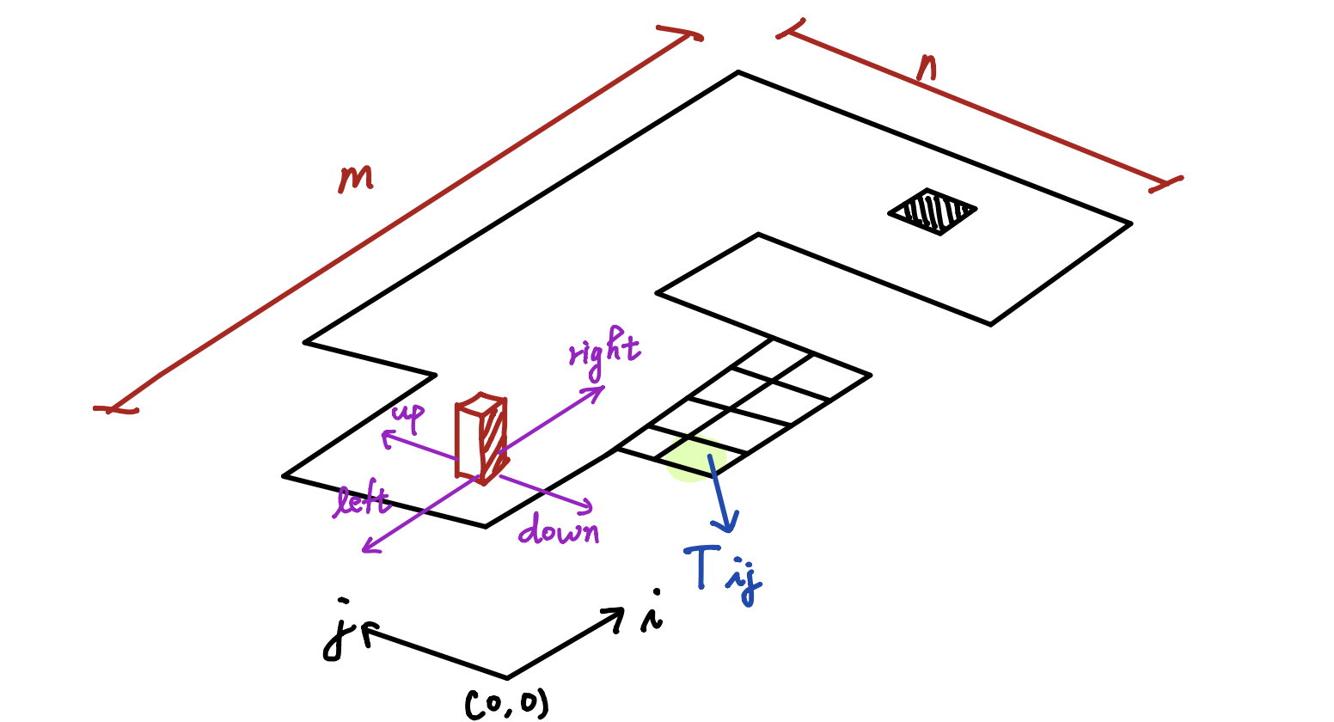
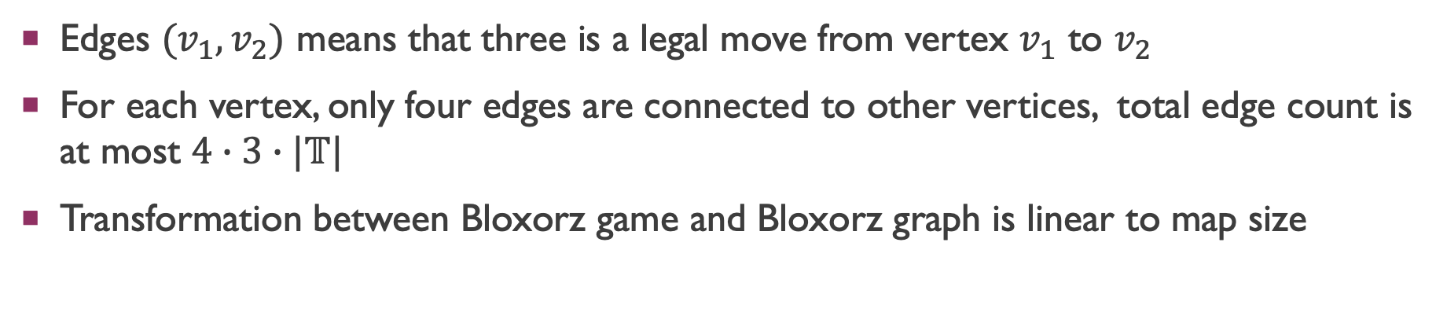
Bloxorz graph
Edges $(v_{1},v_{2})$ means that three is a legal move from vertex $v_{1}$ to $v_{2}$
For each vertex, only four edges are connected to other vertices, total edge count is at most $4∙3∙|𝕋|$
Transformation between Bloxorz game and Bloxorz graph is linear to map size

Slide 9
CNF encoding

Slide 10
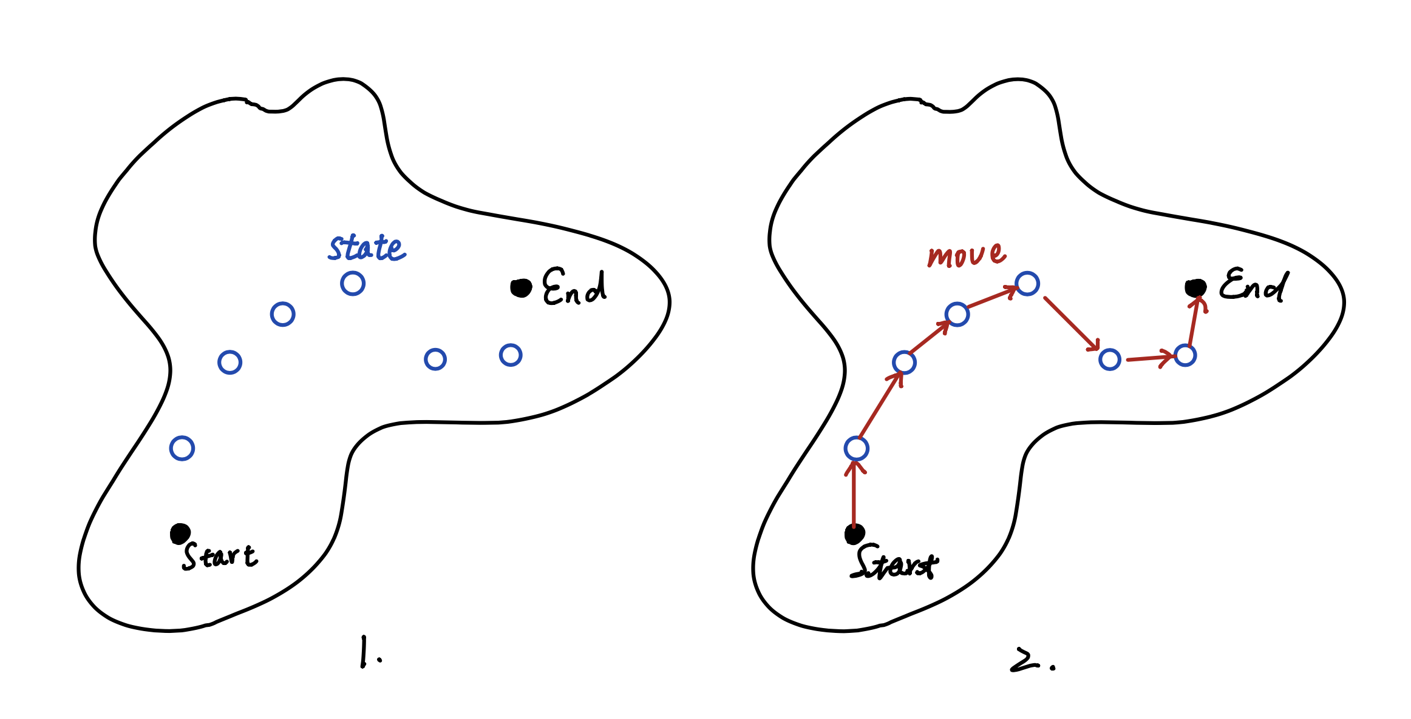
Overall idea
Select a bunch of nodes on Bloxorz graph (these node incorporate location and state info of the block)
Check whether there exist a set of moves (edge) assigned on each selected nodes, to achieve path connection from start to end

Slide 11
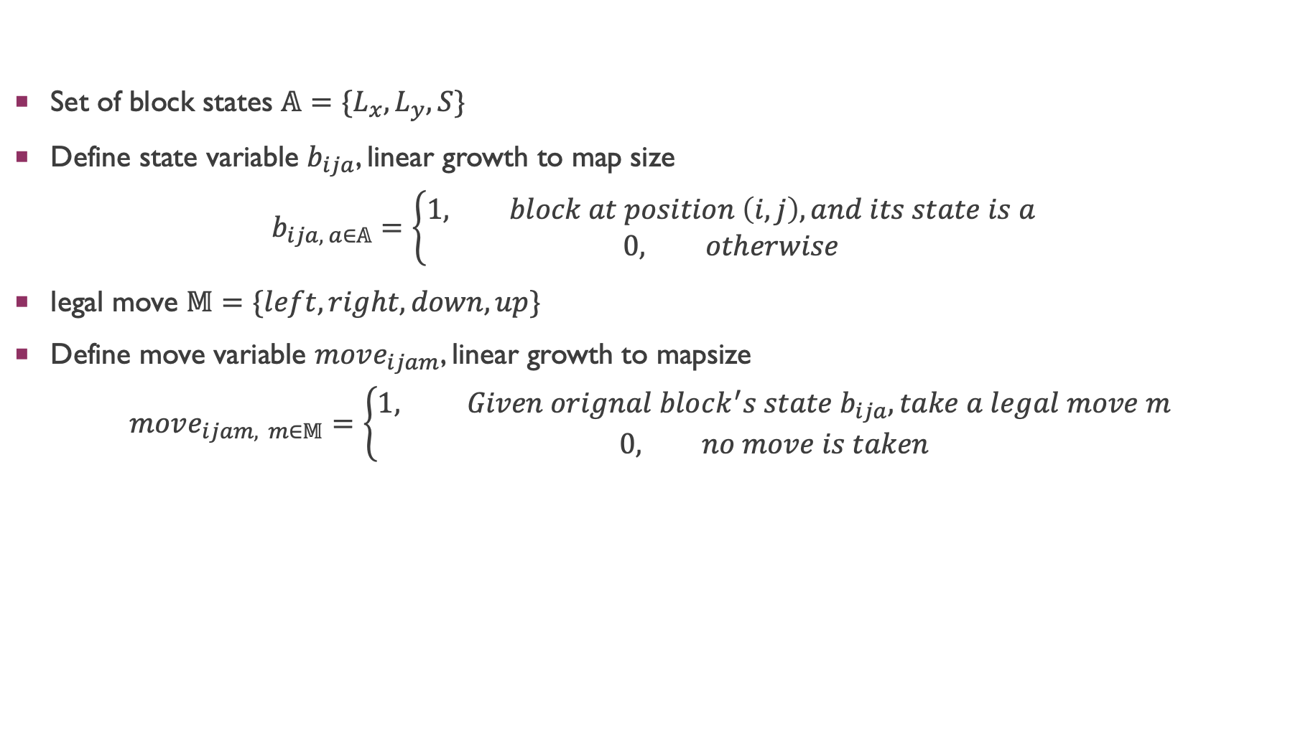
definition
Set of block states $𝔸=\{L_{x}, L_{y}, S\}$
Define state variable $b_{ija}$, linear growth to map size
$$b_{ija, a∈𝔸}=\left\{\begin{aligned}1, block at position \left(i, j\right), and its state is a \\ 0, otherwise\end{aligned}\right.$$
legal move $𝕄=\{left, right, down, up\}$
Define move variable $move_{ijam}$, linear growth to mapsize
$$move_{ijam, m∈𝕄}=\left\{\begin{aligned}1, Given orignal block^{′}s state b_{ija}, take a legal move m \\ 0, no move is taken\end{aligned}\right.$$

Slide 12
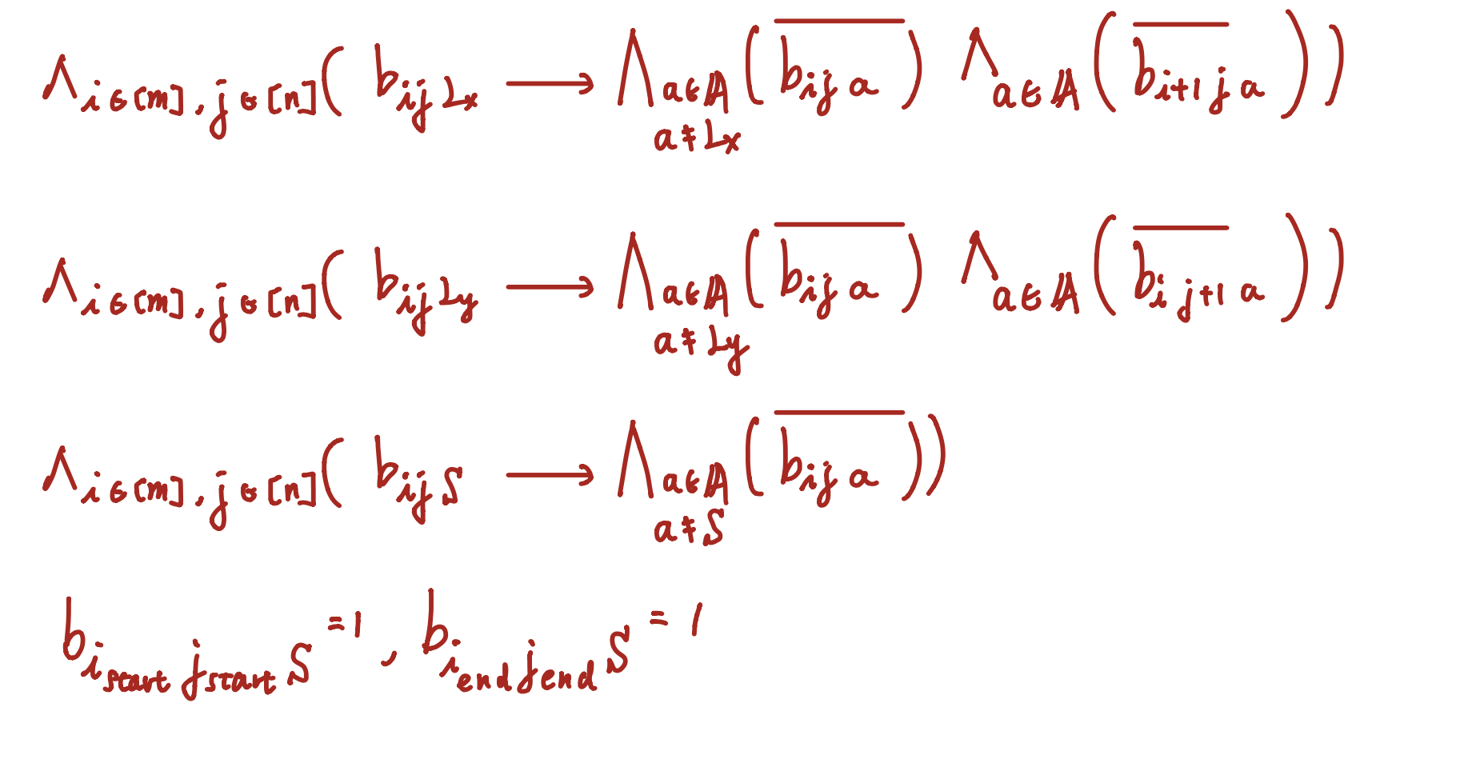

Rules - Select a bunch of states $b_{ija}$
Since a tile can not be passed twice, a whenever a state is taken, some of states are no longer available
Block is originally stand at start point, and it must end standing at goal hole, these two states must be 1
Total clause number: O(map size)

Slide 13
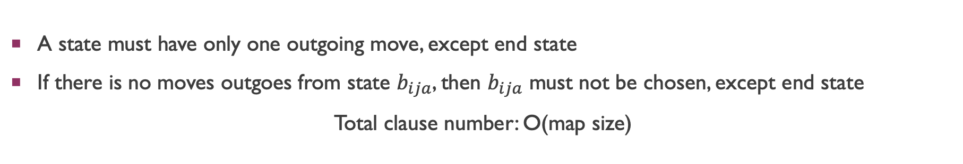
Rules – Choose a set moves
A state must have only one outgoing move, except end state
If there is no moves outgoes from state $b_{ija}$, then $b_{ija}$ must not be chosen, except end state
Total clause number: O(map size)

Slide 14
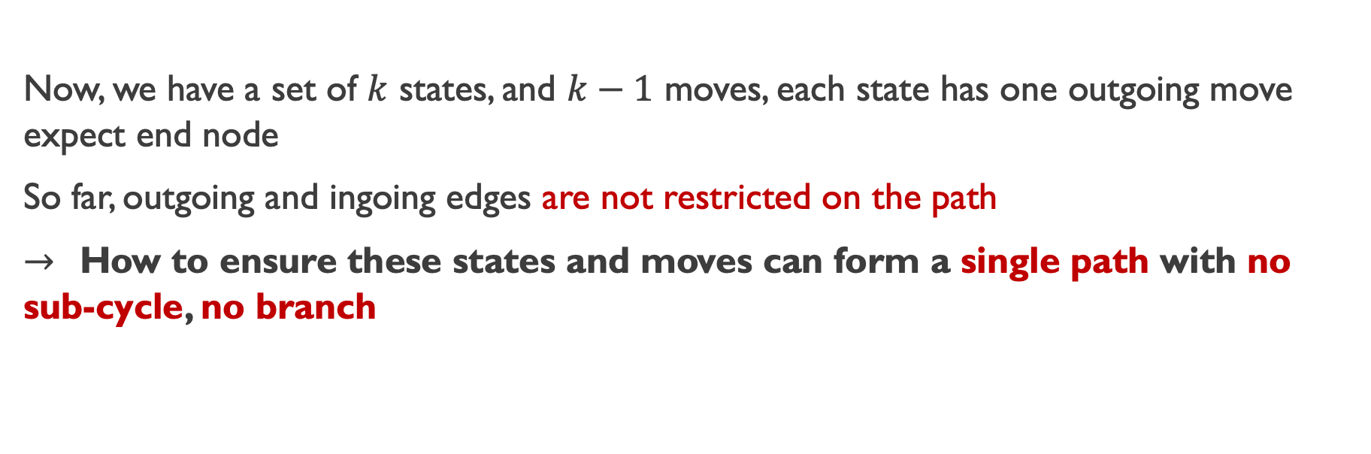
Rules – Successor function
Now, we have a set of $k$ states, and $k−1$ moves, each state has one outgoing move expect end node
So far, outgoing and ingoing edges are not restricted on the path
$→$ How to ensure these states and moves can form a single path with no sub-cycle, no branch
Reference : SAT Encoding for the Hamiltonian Cycle Problem

Slide 15
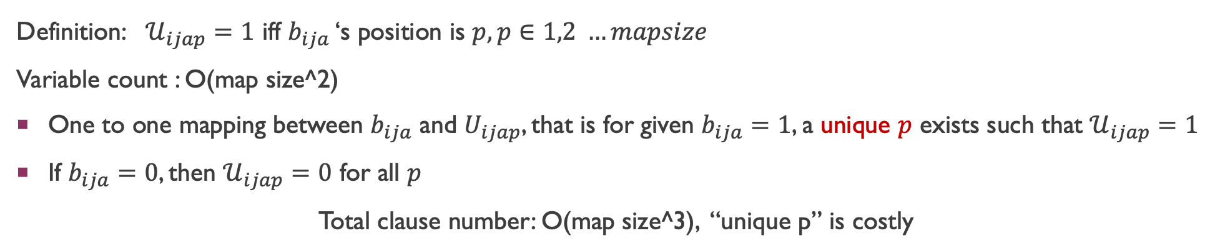
Rules – Successor function
Definition: $𝒰_{ijap}=1$ iff $b_{ija}$ ‘s position is $p, p∈1,2 …mapsize$
Variable count : O(map size^2)
One to one mapping between $b_{ija}$ and $U_{ijap}$, that is for given $b_{ija}=1$, a unique $p$ exists such that $𝒰_{ijap}=1$
If $b_{ija}=0$, then $𝒰_{ijap}=0$ for all $p$
Total clause number: O(map size^3), “unique p” is costly

Slide 16
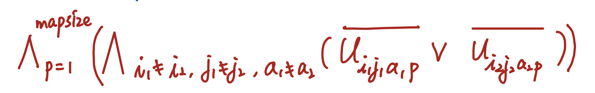
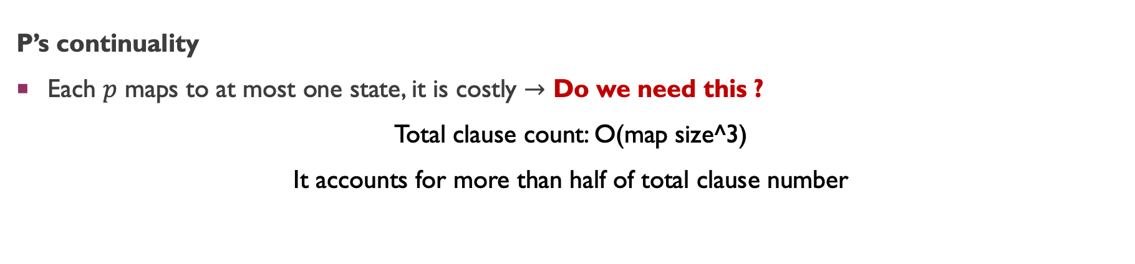
Rules – Successor function
P’s continuality
Each $p$ maps to at most one state, it is costly $→$ Do we need this ?
Total clause count: O(map size^3)
It accounts for more than half of total clause number

Slide 17
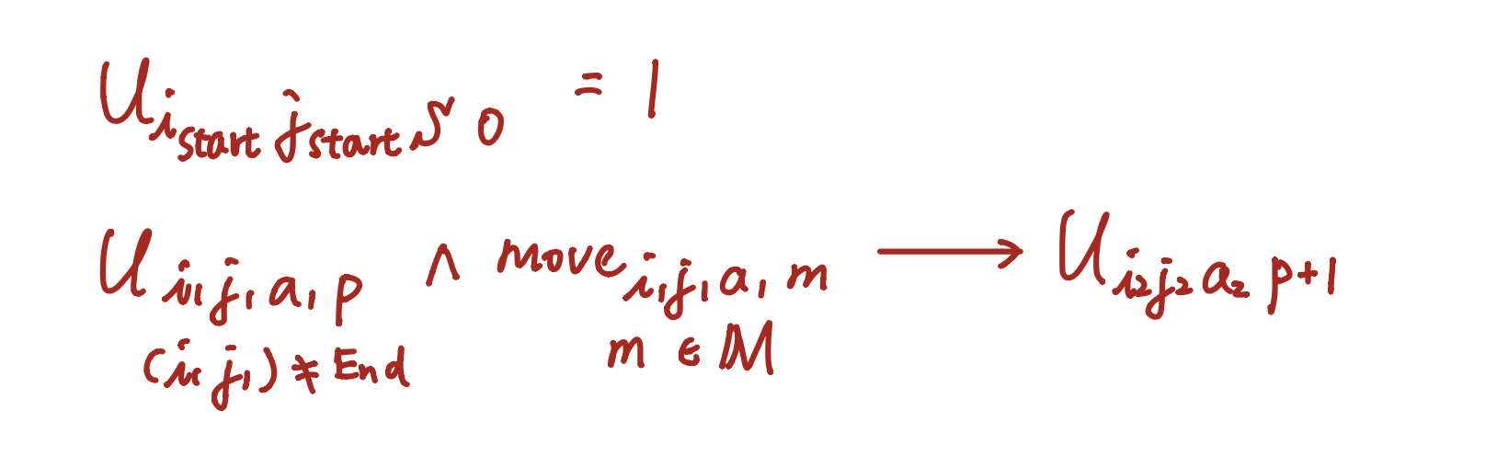
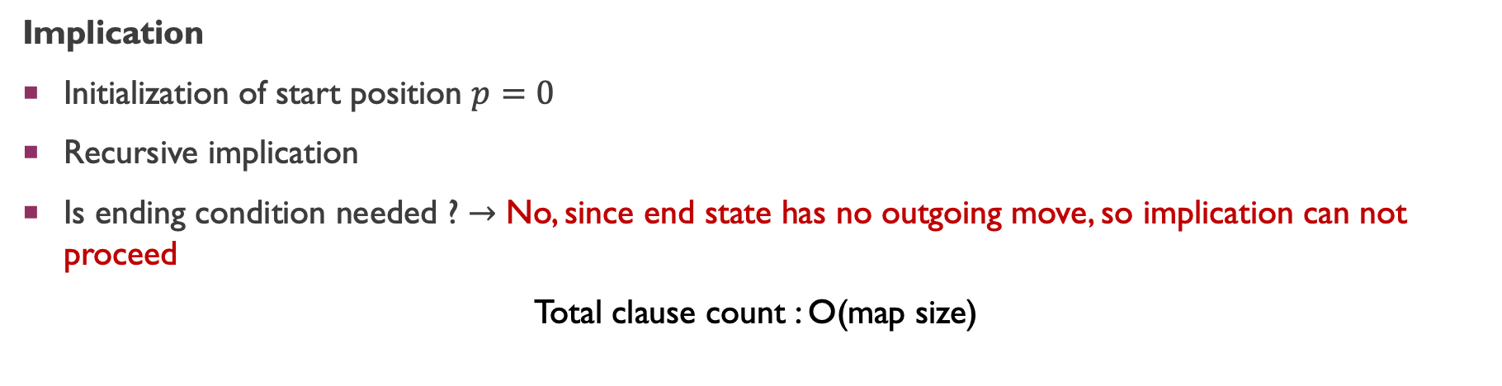
RULES – successor function
Implication
Initialization of start position $p=0$
Recursive implication
Is ending condition needed ? $→$ No, since end state has no outgoing move, so implication can not proceed
Total clause count : O(map size)

Slide 18
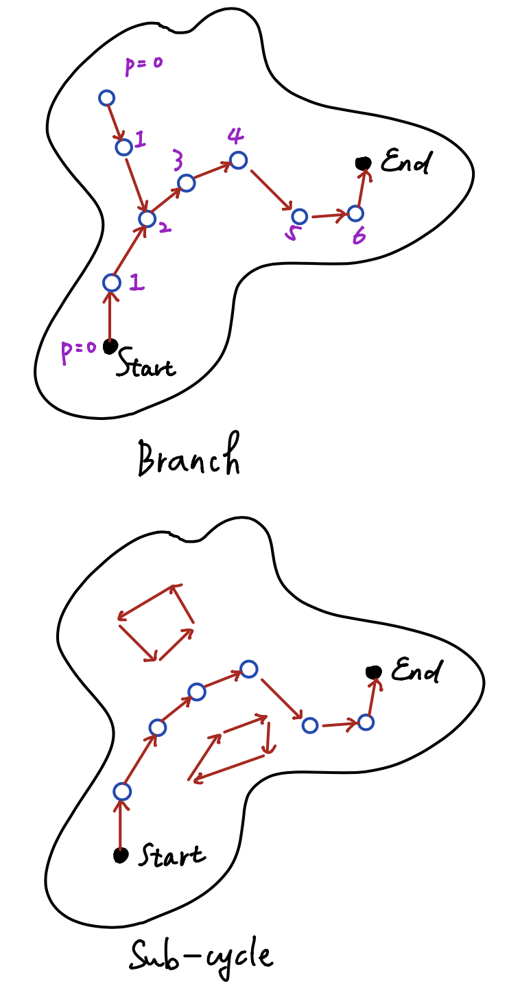
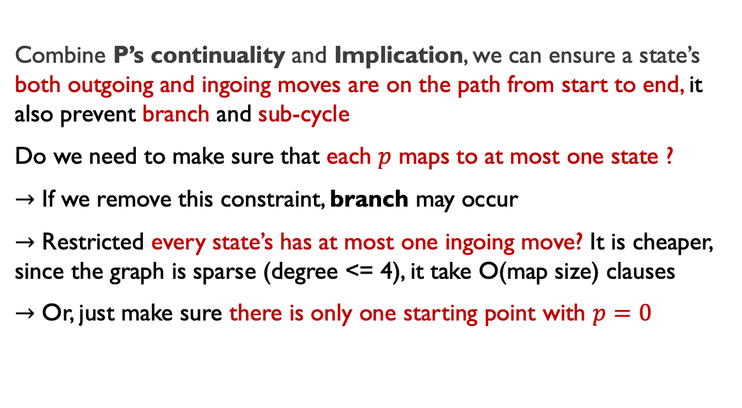
RULES – successor function
Combine P’s continuality and Implication, we can ensure a state’s both outgoing and ingoing moves are on the path from start to end, it also prevent branch and sub-cycle
Do we need to make sure that each $p$ maps to at most one state ?
$→$ If we remove this constraint, branch may occur
$→$ Restricted every state’s has at most one ingoing move? It is cheaper, since the graph is sparse (degree <= 4), it take O(map size) clauses
$→$ Or, just make sure there is only one starting point with $p=0$

Slide 19
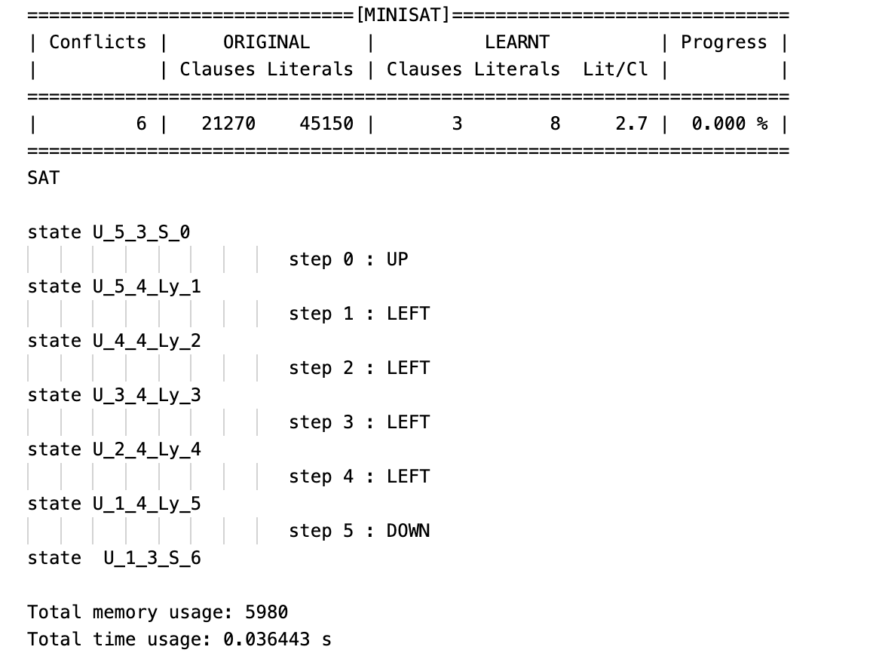
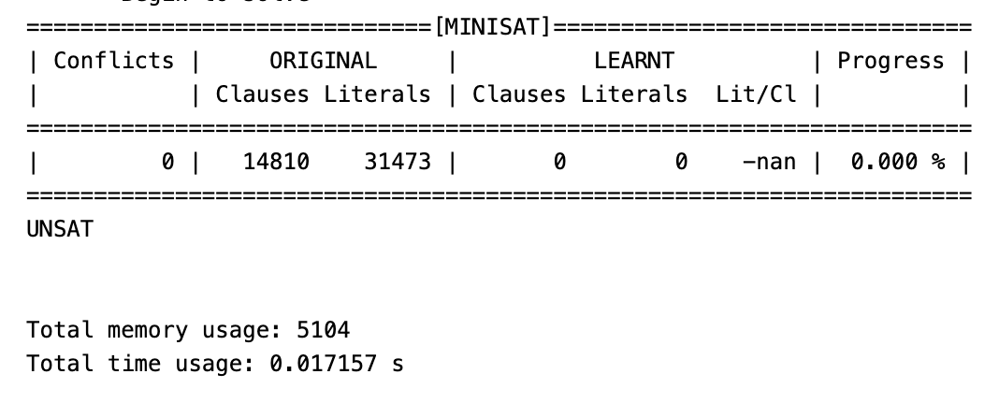
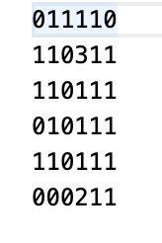
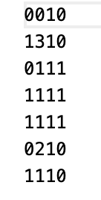
Experiment
Map1
Map2
Map1
LEFT
j
DOWN
UP
i
RIGHT

Slide 20
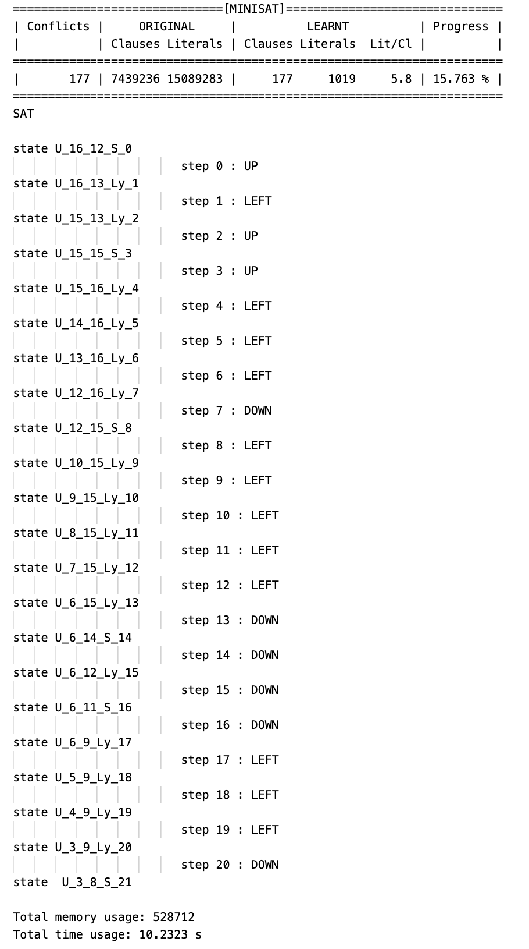
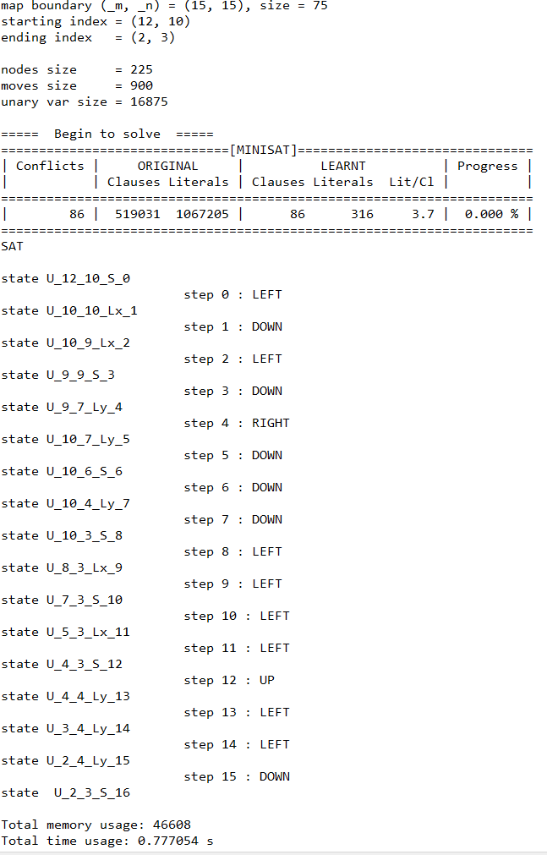
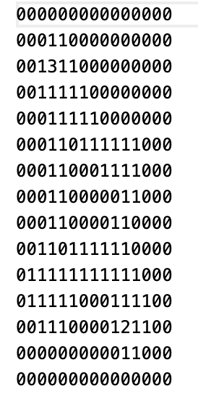
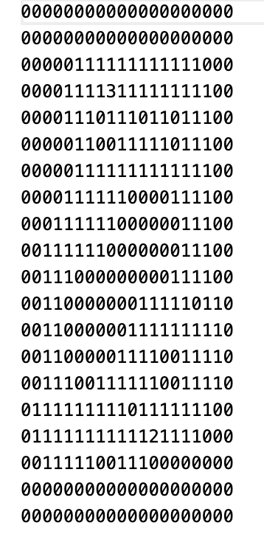
experiment
Map3
Map4
LEFT
DOWN
UP
RIGHT

Slide 21
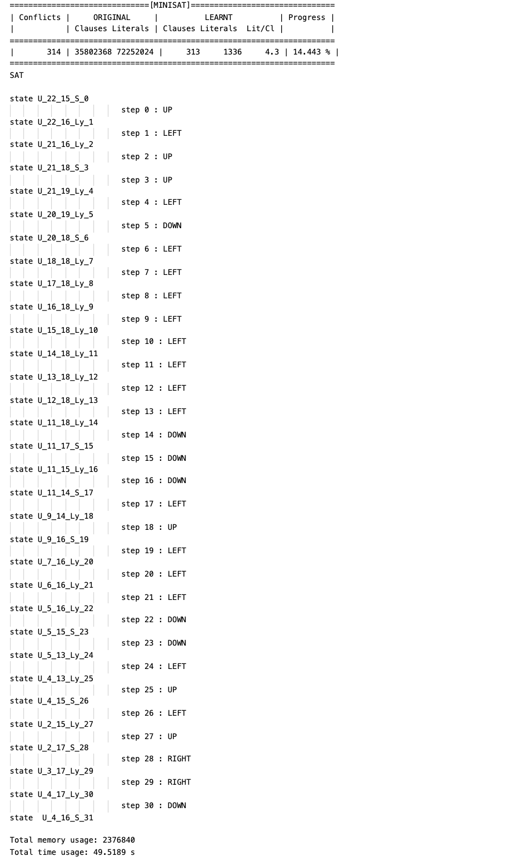
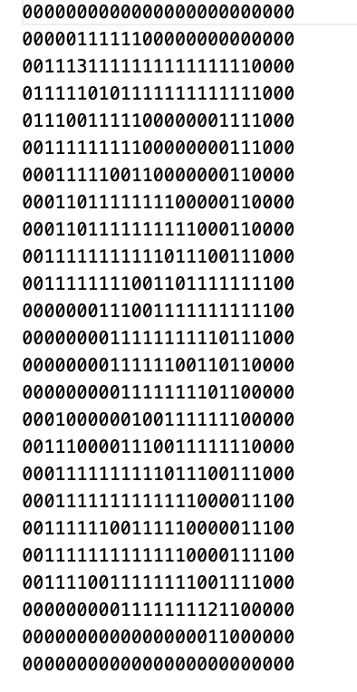
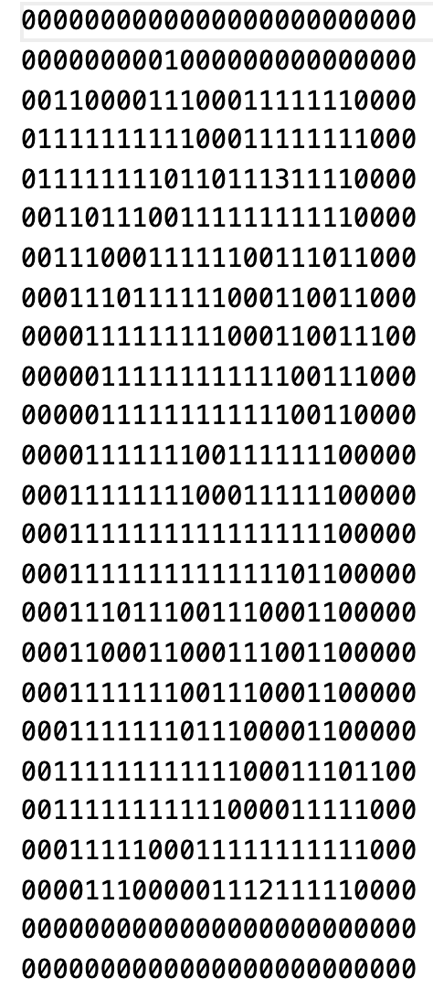
experiment
M5
M6

Slide 22
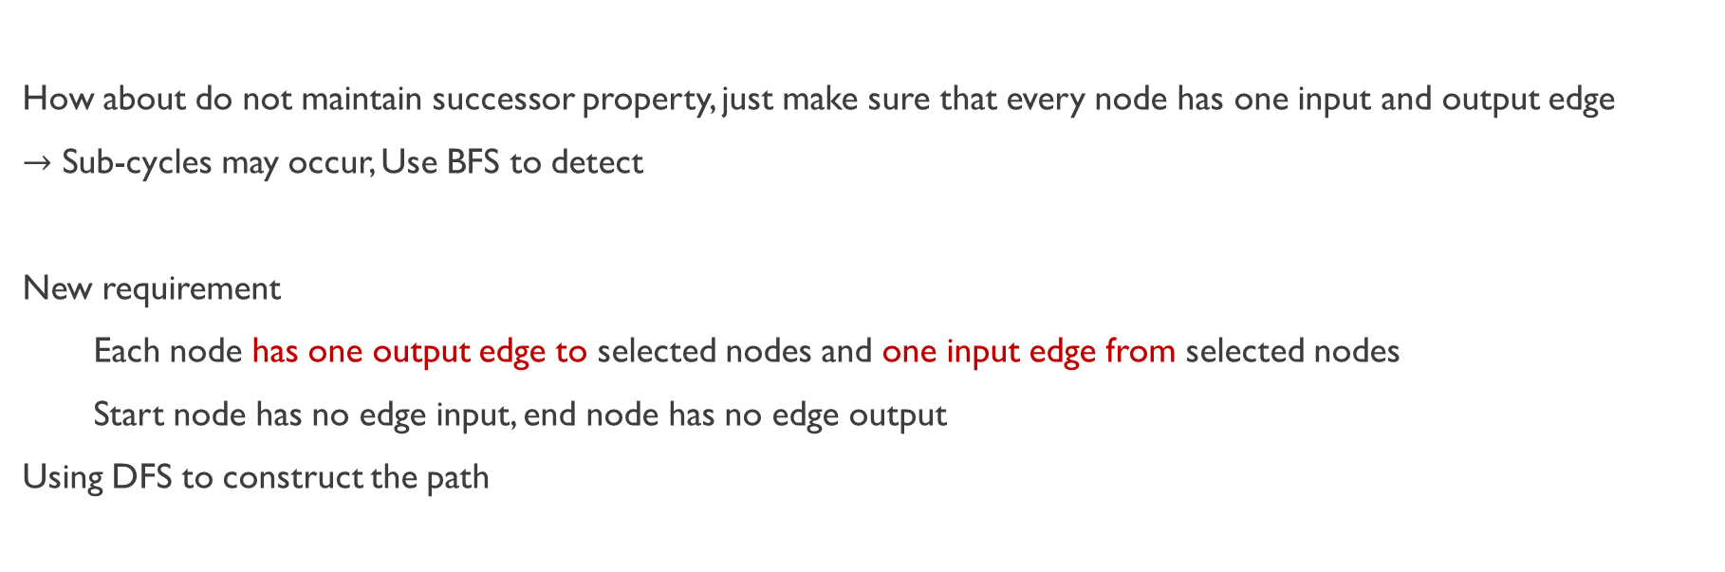
Improvement
How about do not maintain successor property, just make sure that every node has one input and output edge
$→$ Sub-cycles may occur, Use BFS to detect
New requirement
Each node has one output edge to selected nodes and one input edge from selected nodes
Start node has no edge input, end node has no edge output
Using DFS to construct the path

